Slide 1
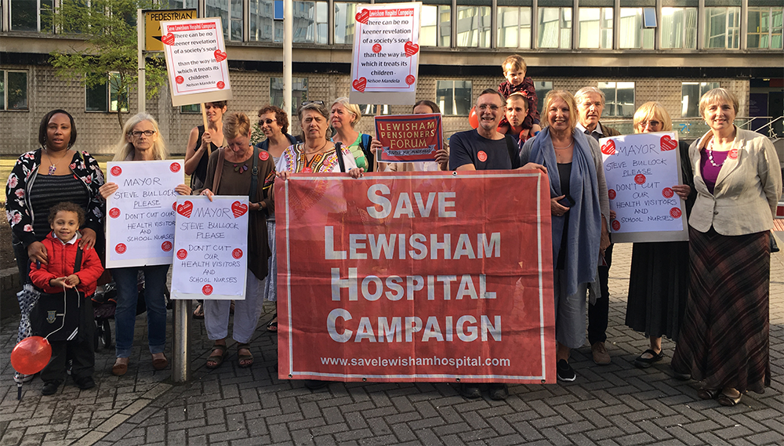
Some ideas on campaigning

Slide 2
Some ideas on campaigning from our campaign
Before and during our campaign - 2012 - present we have seen so many wonderful examples of campaigns and campaigning eg the wonderful 999 march from the north east to London, the campaign in north west London fighting the biggest hospital closure programme in the country.
Our campaign is one among many we won a major victory and we happened to be in London
Watch video to give you a flavour of our campaigning to save our hospital including demos, pickets, leafleting, meetings, petitions – buggy armies, trolley armies, people’s commission, legal campaign
Handout

Slide 3
Main points
Clear aims
Involvement – whole community – united front
Clinicians – doctors, nurses, staff – voices on inside
Structure of campaign
Regular events, special events – appealing and involving
Press coverage
Social media and website
Local council and MPs
Legal campaign
Peoples Commission

Slide 4
Latest phase of our campaign
Supporting and working with other campaigns - practical and campaigning support
Supporting Junior Doctors, Nurses bursary campaign, GMB staff
Linking with national organisations – Keep Our NHS Public, NHS Bill, Health Campaigns together, Momentum
Producing regular leaflets – leafleting, distributing through organisations – pensioners forum, LP, Green Party
Opposing cuts in children’s services – online petition, leaflet, working with nurses to respond to public consultation – putting advice on website, regular pickets of council meetings
STP - Attending and intervening at Our Healthier South East London meetings - STP
Offering to speak at local groups and organisations to explain STP and other issues
Attending local council meetings to oppose cuts, on STP – briefing sympathetic councillors, asking questions, asking to speak
Maintaining a strong local press and social media presence

Slide 5
Ideas from other campaigns
Huddersfield – merchandise, posters, use press, visit to London, petition of 145,000
Stafford - camp – Grantham vigils in week bringing campaigners together
Live Facebook reports

Slide 6
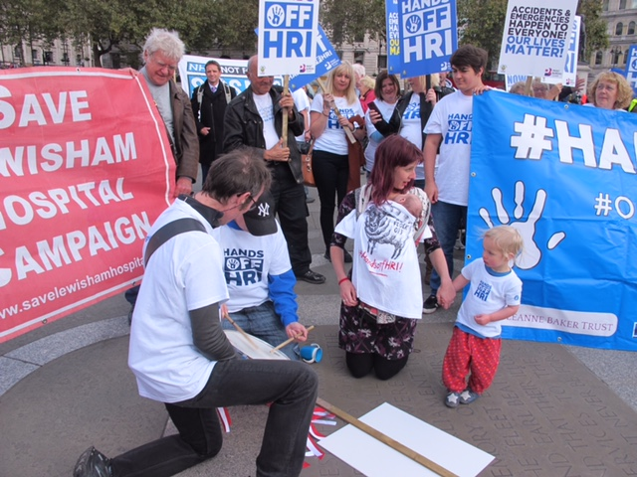
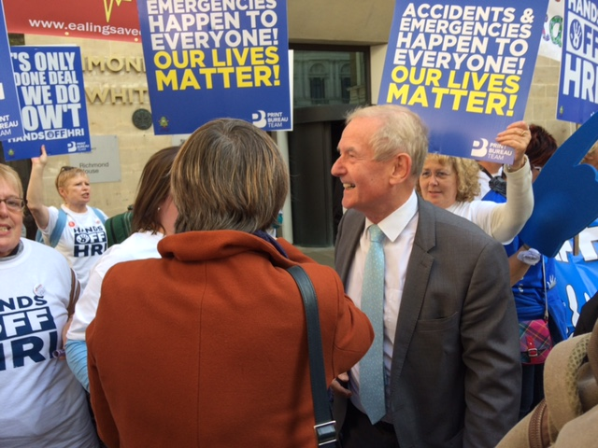
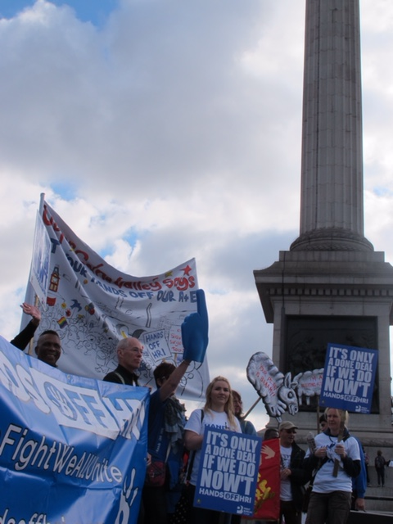

Slide 7
