Slide 1
Our NHS under attack – austerity, privatisation, STPs.
Louise Irvine
Chair of Save Lewisham Hospital Campaign
Member of KONP/Health Campaigns Together
(with thanks to Professor Colin Leys, John Lister and Unite the Union, some of whose work I’ve used for this presentation)

Slide 2
Overview of talk
Government Health Policy
Austerity and funding
Privatisation and PFI
Cuts, closures and reconfiguration
STPs
Devolution
NHS Reinstatement Bill

Slide 3
Government Health Strategy
Long term aim of dismantling NHS
Set the system up to fail
Cut the funding under guise of “austerity”
Promote privatisation and market systems
Create unrealistic unfunded expectations (7 day NHS)
Attack terms and conditions – imposition of Junior Doctors contract
Promote concept of charges, insurance, personal budgets
End of the NHS – a two tier system

Slide 4
NHS underfunding
https://www.facebook.com/amar.mashru/videos/10101005281939336/

Slide 5
The myth of the “£10 billion extra for the NHS”
“double counting” extra £2 billion from last parliament, most of which recycled NHS money
Discounted £3 bn NHS funding removed from public health, capital budgets and doctors and nurses training budgets
Dr Sara Woolaston, chair HSC said its £4.5bn
Sally Gainsbury, Nuffiend Trust says it’s £800 million

Slide 6
NHS Funding is flat
  0.9% average annual rise 2015-2020 – same as 2010-2015.
  Per capita it’s 0.1% per annum.
  Lowest increase in any decade ever.
  average annual increases of
    5.7 per cent under the Labour administrations between 1997/8 and 2009/10 and
    3.2 per cent under the Conservative administration between 1979/80 and 1996/7.

Slide 7
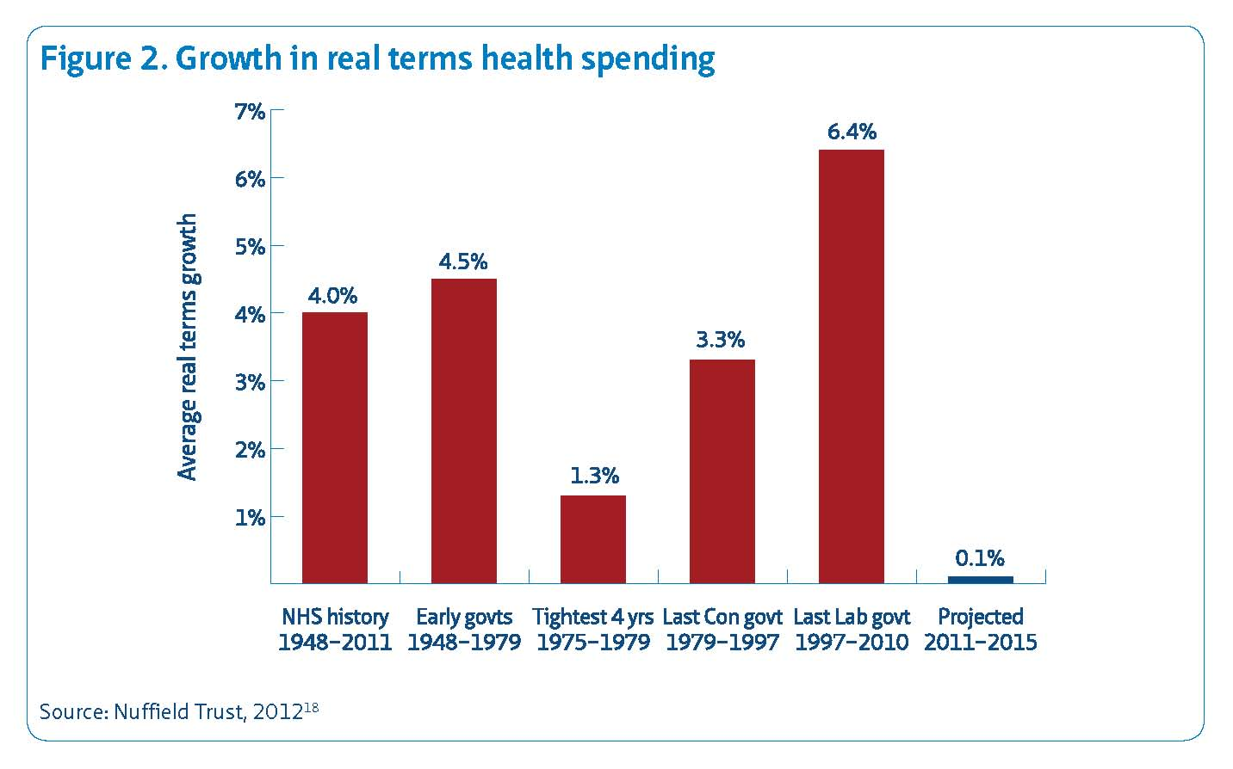
Historic NHS funding

Slide 8
NHS spend as %GDP
We spend 8.5% of GDP on health which is 2.5% less than compa rable European countries
France 10.9%, Germany 11.0%, the Netherland 11.1%,
  Largest ever sustained reduction in UK NHS spending as a percentage of GDP
  Almost back to pre 2000 level, before commitment to increase to EU average

Slide 9
£22 billion funding gap by 2020
Since 2010 NHS budget almost static
Growing health care needs and costs would require 3-4% annual increase.
This is the basis for the predicted £22 billiion funding gap by 2020.
NHS hospitals in England likely to have overspent their 2015-16 budgets by £2.5bn.

Slide 10
“The emperor has no clothes”
“NHS leaders have never felt this target was credible and are now wondering when the emperor will be seen to have no clothes. Many feel as if they are living in a parallel universe in which they are striving to sustain existing services in conditions of adversity while politicians promise improvements in care that cannot be delivered with available resources.”
(Chris Ham, Kings Fund)

Slide 11
NHS Staff
  Pay freeze 15% real terms pay cut, and continued pay cap
  Junior doctors – redefining antisocial hours – nurses etc next
  Low morale. Not enough staff (e.g. Mid Staffs, Addenbrooke’s failed CQC)
  Nurse training places cut in 2012
  NHS bursaries replaced with loans
  STPs: downskilling and local pay, T&C
  Privatisation and outsourcing

Slide 12
NHS Privatisation
for-profit and non-profit private providers undertake services paid for and previously provided by the NHS
Thatcher: contracting out support services (cleaning, laundry, portering, catering). NHS staff cut and casualised
Labour: privatised clinical services e.g. independent sector treatment centres.
  Accelerated after H&SC Act 2012 and section 75

Slide 13
Privatisation – what’s wrong with it?
Huge costs of running market in health care,
Private companies cut and downgrade staff
Shareholder dividends take money from NHS
“Cherry picking” undermines NHS services
Unaccountable
Parasitical on NHS for emergencies and staff
Fragmentation – inefficient use of resources

Slide 14
Costs of the market
Bureaucracy and purchaser-provider split
Transaction costs
Diversion of clinical and management time
Cost of management consultants, lawyers, accountants
Estimated £5-10 billion
2010 Commons health select committee declared PP split a “costly failure”

Slide 15
Rate of privatisation
  Government claimed only 6% of clinical services privatised but that was just until 2013, before section 75 regulations kicked in.
Amount of NHS contracts awarded through the market rising significantly.
Now abut 10% of clinical services provided by private sector.

Slide 16
NHS Support Federation
In first six months since Health and Social Care Act came into effect (apr-sep 2013) over £400m of NHS contracts awarded.
A year later the number of awards in the same six-month period had doubled and their value was over seven times higher, at £3bn.
This financial year (2015/16)private sector won £2.1 billion worth of clinically related NHS contracts (37%). The not for profit sector won £955 million worth (16%) and the NHS won £2.7 billion worth (47%)

Slide 17
Privatisation targets
Community care
Elderly and end of life care
Cancer care
Ambulance service
Mental health
General practice
Management and support services

Slide 18
Some examples
Virgin Care will be given a £700million contract to run NHS Bath and North East Somerset - the first time a for-profit firm will deliver a council's social care for adults.
Spending on private firms to provide 999 ambulances has doubled in the last three years from £24m to £56m.
Circle Health awarded contract to run musculoskeletal services in Greenwich

Slide 19
Private Finance Initiative
Labour Government initiated dozens of hospital PFI schemes. Continued under Coalition and Tories.
Costs were twice as much as government procurement. “buying house with a credit card”
9 out of the 15 most in debited trusts have PFI schemes.
Cost to public purse will be £80bn for hospitals that cost nearly £13bn to build.

Slide 20
NHS hospitals get in on the act
perverse situation whereextra capacity in trusts is being used for private care, while 3.7 million NHS patients wait for treatment – the most since December 2007.
Trusts across England saw a 14% increase in income from private patients between 2012/13 to 2015/16.
Royal Brompton and Harefield NHS Foundation Trust brought in £39.3m in private income in 2015/16 – a 36% increase on 2012/13 – at a time when it is going through remedial action for missing waiting time targets.

Slide 21
Special investigation by Pulse shows private healthcare in the UK is buoyant.
major healthcare companies profits double, citing pressures on NHS.
BMI Healthcare says it more than doubled profits last year. Spire, which runs a network of 38 private hospitals, has seen revenue and patient volumes increase by 30% and 20% respectively in the past five years,
‘self-pay’ market could grow by 10-15% a year over the next three years.
CCGs expanding use of private sector to reduce waiting lists, with commissioning of care from private hospitals growing by 18% between 2013/14 and 2015/16.

Slide 22
Simon Stevens 5 Year Forward View
Published October 2014 by NHS England, “vision for future” based on new models of care:
  Multi -specialty community providers
  primary and acute care systems
  urgent and emergency care networks
Aims to save £22bn pa by 2021 – linked to STPs
Major service reconfigurations i.e. cuts and closures
“accountable care organisations”: ripe for privatisation

Slide 23
Devolution
Government divesting itself of responsibility for its health and social care decisions, passing blame to local authorities
  No guarantee of national entitlement to universal and comprehensive service.
  Grossly inadequate funding of health and social care
  Redefining health as social care so it can be means tested and charged for
  Lack of democratic accountability.

Slide 24
Sustainability and Transformation Plans
NHS England’s document, Delivering the Forward View: NHS planning guidance 2016/17 – 2020/21, published just before Christmas 2015.
calls on ‘local health systems’, consisting of ‘clinicians, patients, carers, citizens, and local community partners including the independent and voluntary sectors, and local government through health and wellbeing boards’, to
‘work together to develop robust plans to transform the way that health and care is planned and delivered for their populations’.

Slide 25
STPs
Sustainability
  To “balance” health budget by 2018 and eliminate the deficit
  Meet target of £22 bn “efficiency savings’ by 2021
Transformation
  New models of care (5 Year Forward View)

Slide 26
Sustainability and Transformation Plans (STPs)
England carved into 44 STPs covering on average 1.2m people, 3 or 4 councils, 5 CCGs
Final STPs to be announced after October
Limited Consultation January 2017
Implementation during 2017
No statutory underpinning
Secret

Slide 27
No legal basis exists for making STPs
Commons written answer tabled on 7 June 2016
To ask the Secretary of State for Health, what the legal status of a Sustainability and Transformation Plan will be. (39613)
George Freeman:
“The Sustainability and Transformation Plans (STP) has no legal basis. Any plans submitted will be proposals that will form the basis for discussion. Depending on the level of local and national agreement, they may form the basis for further plans and actions that will be subject to the same legal and best practice requirements that govern the National Health Service.”

Slide 28
A new ‘top-down reorganisation’, but unaccountable
There are no legal structures for making plans for the ‘footprint’ areas comprising several local authorities and CCGs
The planning process is informal and secret
The plans are not subject to scrutiny by parliament, and no person or organisation is accountable for the consequences

Slide 29
What every STP must do
By 2021 the gap between the funds needed to maintain the existing level of NHS services and what the government proposed to spend, is about £30bn.
George Osborne allocated additional funds reaching £10bn a year by 2021, to allow the NHS to transform itself in such a way as to close the remaining gap of £20bn
Each ‘local health economy’ must therefore spend on average £20bn/44, or £450 million a year, less by 2021
This is being enforced by tight Treasury controls on CCGs and the threat of losing a share of the STF

Slide 30
STPs – what the pundits say
King’s Fund says that ‘It is inconceivable that the NHS will be able to achieve both financial sustainability and large-scale transformation within these financial constraints’.
Julia Simon, former head of NHSE’s commissioning policy unit said: ‘Everyone will submit a plan, because they have to. 'But it means there is a lot of blue sky thinking and then you have a lot of lies in the system about the financial position, benefits that will be delivered - it’s just a construct, not a reality.'

Slide 31
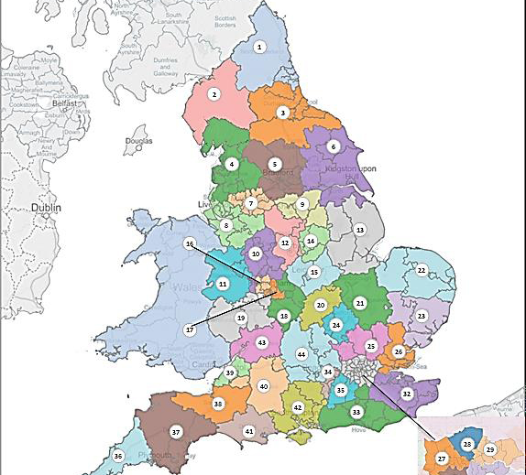

Slide 32
STPs “soft sell”
Improving health and wellbeing through better prevention of ill health
Reducing demand for hospital beds by better care in the community
Concentrating services in specialist hospitals providing 7 day services

Slide 33
STPs – the reality
Cuts to public health and prevention. Sale of NHS assets.
Community care. No evidence reduces need for hospital beds.
Centralising care in specialist hospitals destroys local provision with risks to access, quality and safety
radically alters the shape, constitution and very nature of our NHS.

Slide 34
STPs = cuts
STP Northumberland, Tyne & Wear Predicted deficit = £960m
STP SE London Predicted deficit = £1 billion
Only £1.8bn of STP funding available for England as a whole

Slide 35
What is at stake in the STP programme
NHSE’s intention is said to be that STPs will be embodied in contracts early next year
If the plans turn out to rest on unrealistic assumptions, the cuts will have been made but the compensating transformations in care will not be achieved
The result would then be a reduced and/or lower quality health service for most patients, and a shift to private care by those who could afford it, in effect ending the NHS as a full and high quality service for all

Slide 36
Reconfigurations
Tories are carrying on relentlessly with so called reconfiguration plans.
STPs will accelerate the process.
Aimed at closing our district general hospitals but dressed up as bringing care closer to home and improving hospital services
Claim to have clinical support but in fact no convincing evidence base

Slide 37
Reconfiguration in Northumberland
A single “accountable care organisation” (ACO) in Northumberland for whole of the area from 2017. Sounds good?
Involves major hospital cuts, mythical “care in the community” and promised increase GP access when not enough GPs.
One big emergency hospital at Cramlington
Closure of A&Es at Hexham, Wansbeck and North Tyneside hospitals

Slide 38
Hospital closures
Huddersfield Royal Infirmary, Banbury Hospital, Oxfordshire, Chorley Hospital, Lancashire, many hospitals in north and south London, hospitals in Leicester, Manchester and many other places
Not just DGHs – community hospitals too. More than half of community hospital beds in East Devon could be closed under proposals published by NHS North, East and West Devon CCG.

Slide 39
NHS Bill 2015
(NHS Reinstatement Bill)
The NHS Bill, presented by Margaret Greenwood MP (Labour, Wirral West), was scheduled for its Second Reading in Parliament on 4th November 2016.
the NHS Bill debate was postponed until Friday 24th February 2017.
The campaign continues. Please ask your MP to support the NHS Bill.
http://www.nhsbill2015.org

Slide 40
The fightback
Local and national campaigns against cuts, closures and privatisation
Regional and national co-ordination, sharing of info and experience, mutual support
Information resources and social media
Support for NHS staff in struggle, working with the health unions
Support NHS Bill
Save Our NHS Demo London March 4

Slide 41
NHS Bill
presented to Parliament 5 times, each time getting more support
Lord David Owen, Caroline Lucas MP, Margaret Greenwood MP
Cross party support
Labour Conf supported
Second reading in February 2017
Depends on us to campaign for it, build support, lobby MPs to attend debate and vote for it

Slide 42
The NHS Bill
proposes to fully restore the NHS as an accountable public service by reversing 25 years of marketization in the NHS,
abolishing the purchaser-provider split, ending contracting and re-establishing public bodies and public services accountable to local communities.
Scotland and Wales have already reversed marketization and restored their NHS without massive upheaval. England can too.

Slide 43
Another top down reorganisation?
Critics of NHS Bill say “we don’t want another top down reorganisation” but don't recognise NHS is being constantly reorganized – or redisorganised.
“Creative destruction”, Devolution, 5 Year Forward View, 7 day services, GP provider companies, new models of care, vanguards, hospital chains and accountable care organisations.
NHS Bill will stabilise the NHS; reinstate as public service; focus resources and energy where needed

Slide 44
NHS Bill aims to restore NHS as a public service
Our NHS should be an accountable public service which treats patients and staff well.
It should be available to everyone equally, free of charge, and not provided by commercial companies.
These principles have been consistently undermined over the last 25 years – firstly through the internal market and then through the external market. Scotland and Wales have started to undo these changes, but in England the Health and Social Care Act 2012 took marketization to a new level.
These changes need to be reversed, and the NHS returned to its founding vision, before it is too late. This needs legislation.

